Slide 1
Entity Resolution
Yibin Xiong

Slide 2
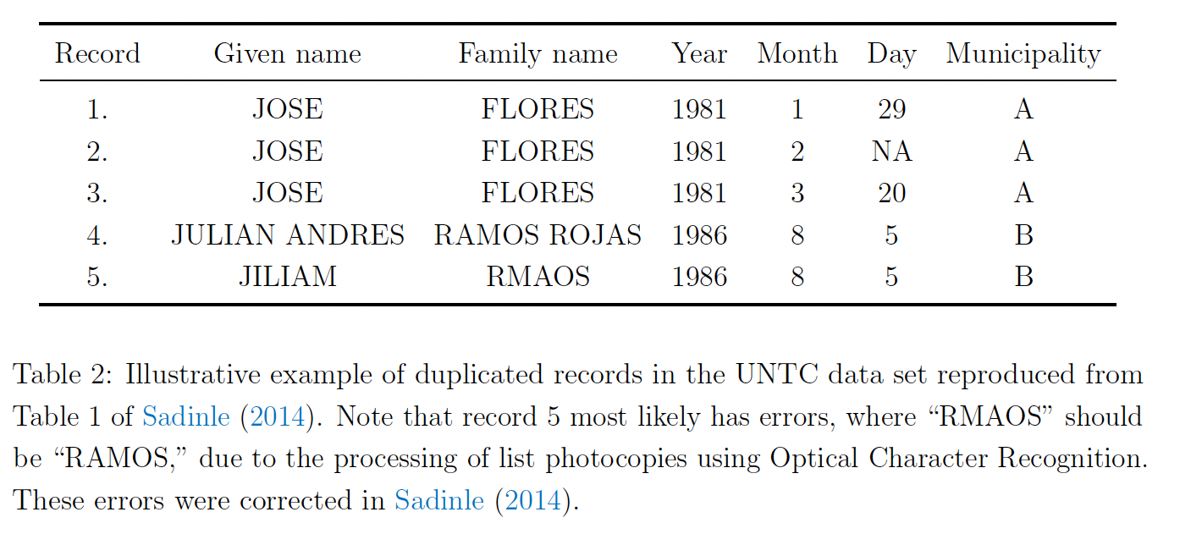
Problem
Matching different records (rows) to the same entity
Within a database: de-duplication
Across multiple databases: record linkage
Unique identifiers are unavailable
Inaccurate and missing data

Slide 3
Pipeline
attribute alignment
blocking
record linkage
canonicalization
Attribute alignment: find the common attributes across databases
Blocking: propose possibly matching pairs (rough filtering)
*Record linkage: classify if candidate pairs match or not (fine filtering)
Canonicalization: merge matched records to a single representative record

Slide 4
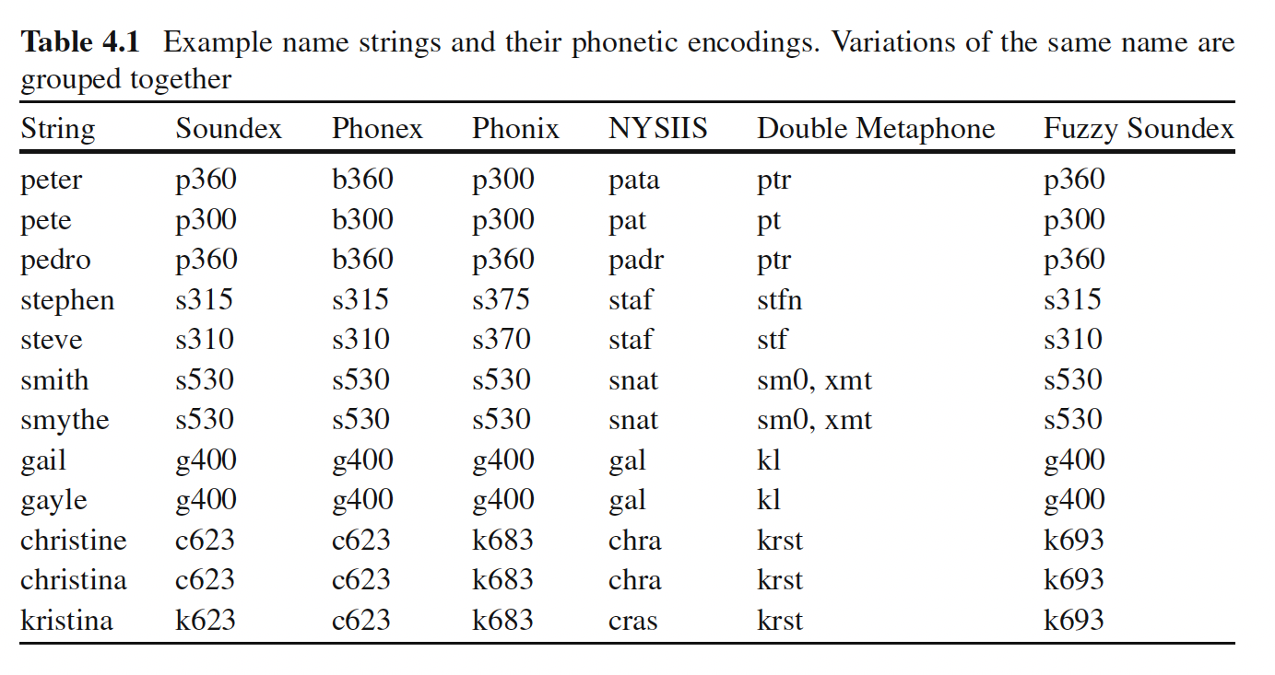
Blocking: Simple, Deterministic Rules
Determine blocking key from one or several attributes
E.g. name; gender AND date of birth
(Optionally,) Map the attribute values to blocking key values (BKVs)
E.g. phonetic encoding functions map names with similar sound to the same code
Group the records with the same BKV together

Slide 5
Id | Last Name | First Name | Postal code
1 | Smith | Anna | 1234 AB
2 | Smith | George | 1234 AB
3 | Schwarz | Ben | 6789 XY
Id | Last Name | First Name | Postal code
1 | Smith | George | 1234 AB
2 | Johnson | Charles | 1234 AB
3 | Schwarz | Ben | 6789 XY
4 | Schwarz | Anna | 6789 XY
A_Id | B_Id | Postal code
1 | 1 | 1234 AB
1 | 2 | 1234 AB
2 | 1 | 1234 AB
2 | 2 | 1234AB
… | … | …

Slide 6
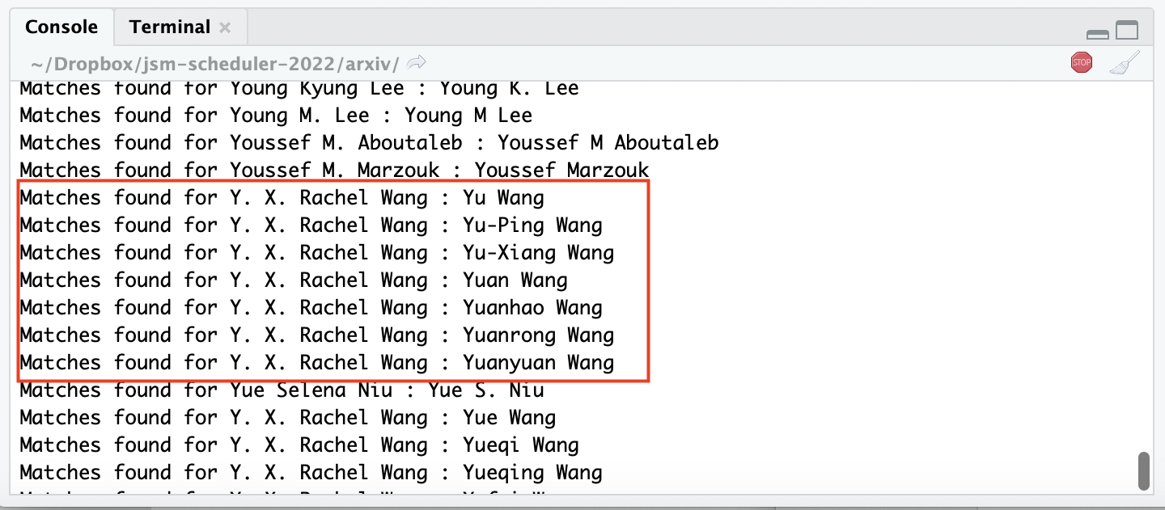
Blocking
In our case, we use the rule of:
The two names must be compatible (i.e. last names exactly match, initials of first names match)
The two records share at least 1 co-author
Problem: Too many false discoveries if no further filtering

Slide 7

Record Linkage: Probabilistic Rules [Fellegi & Sunter 1969]
Let $γ$ = $(γ_{1},…,γ_{k})$ be the comparison vector between two records
Estimate $m\left(γ\right)≔ ℙ(γ∣M)$ and $u\left(γ\right)≔ℙ(γ∣U)$
Consider the log ratio $W(γ)=\log{m\left(γ\right)−\log{u(γ)}}$
Define constants $T_{μ}, T_{λ}$ for controlling the Type I errors $μ, λ$
Match if $W\left(γ\right)>T_{μ}$
Undetermined if $T_{λ}<W\left(γ\right)≤T_{μ}$
Non-match if $W\left(γ\right)≤T_{λ}$

Slide 8
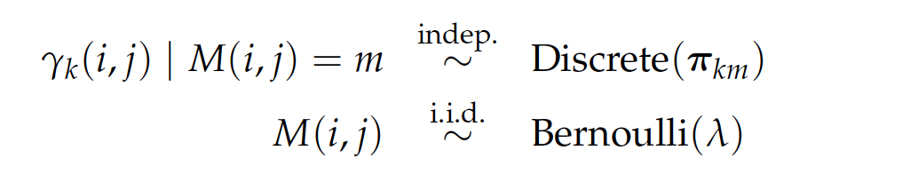
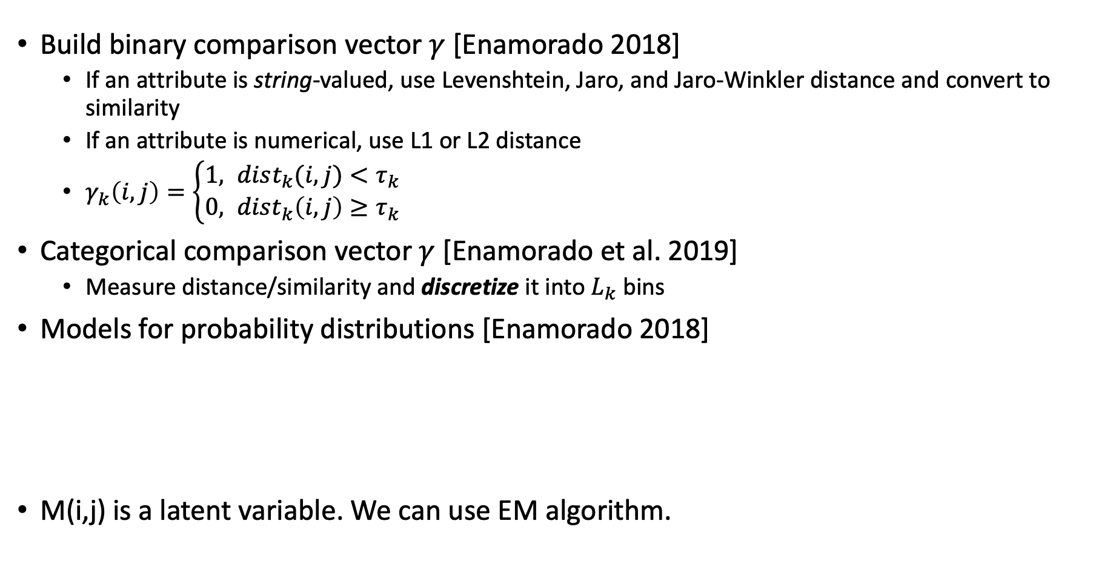
Typical Settings
Build binary comparison vector $γ$ [Enamorado 2018]
If an attribute is string-valued, use Levenshtein, Jaro, and Jaro-Winkler distance and convert to similarity
If an attribute is numerical, use L1 or L2 distance
$γ_{k}\left(i,j\right)=\left\{\begin{aligned}1, dist_{k}(i,j)<τ_{k} \\ 0, dist_{k}\left(i,j\right)≥τ_{k}\end{aligned}\right.$
Categorical comparison vector $γ$ [Enamorado et al. 2019]
Measure distance/similarity and discretize it into $L_{k}$ bins
Models for probability distributions [Enamorado 2018]
M(i,j) is a latent variable. We can use EM algorithm.

Slide 9

Theoretical Properties
Essentially, Fellegi & Sunter method is a likelihood ratio test
The rule is the optimal one in the sense of minimizing the probability of a comparison vector being undetermined
Bound the ratio $\frac{m(γ)}{u(γ)}$ is equivalent to bound the posterior probability
$$ℙ\left(M ∣ γ\right)= \frac{ℙ\left(M\right)m\left(γ\right)}{ℙ\left(M\right)m\left(γ\right)+\left(1−ℙ\left(M\right)\right)u(γ)}=1 −{\left(1+\frac{ℙ\left(M\right)}{1−ℙ\left(M\right)}⋅\frac{m(γ)}{u(γ)}\right)}^{−1}$$
i.e. for very large/small likelihood ratio, the posterior probability is also large/small, in which case we reject the null hypothesis and classify the pair as match/non-match

Slide 10

Details
Our data: very clean, (almost) no error, no missing entries, unsupervised
Produce $γ$ for strings/names:
In our case, names are compatible, which means most similarity scores are high and NOT very discriminative. It may be worth to include it though.
Do we need to tag the names, i.e. separate the name into first, middle, and last name?
Can we use continuous distributions, e.g. Gaussian, to model some $γ_{k}$?
What if $γ$ is a mix of continuous and discrete variables? The joint distribution is complex
Variables to use in 𝛾: # of common co-authors, name similarity score, affiliation, author-words vector inner product?
ArXiv data does not have affiliations; for S2 data, we need to look into “authors” database
For JSM deduplication, can we manually do the match after the deterministic rule?

Slide 11
Software
fastLink: https://github.com/kosukeimai/fastLink
RecordLinkage: http://uribo.github.io/rpkg_showcase/modeling/RecordLinkage.html
reclin (good demo, flexible to use): https://github.com/djvanderlaan/reclin

Slide 13
References
Binette, Olivier, and Rebecca C. Steorts. "(Almost) All of Entity Resolution." arXiv e-prints (2020): arXiv-2008.
Enamorado, Ted, Benjamin Fifield, and Kosuke Imai. "Using a probabilistic model to assist merging of large-scale administrative records." American Political Science Review 113.2 (2019): 353-371.
Enamorado, Ted. "Active learning for probabilistic record linkage." Available at SSRN 3257638 (2018).

